Slide 1
Software Quality Assurance and Testing Technology
2nd Semester, Spring 2022
Xiaoping CHE (xpche@bjtu.edu.cn)
Associate Professor
School of Software Engineering
Beijing Jiaotong University

Slide 2
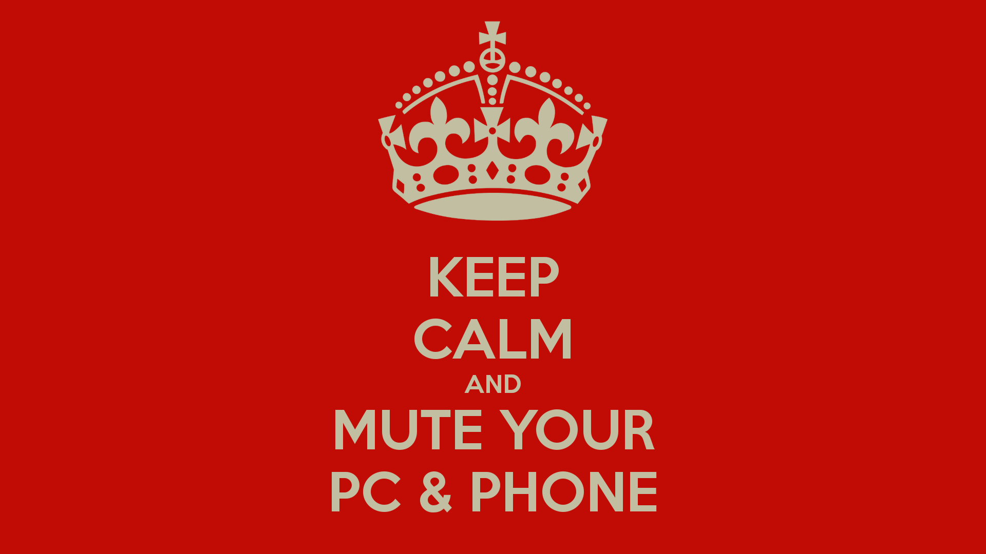



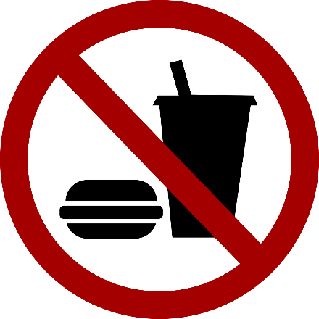
Rules

Slide 3
Rules
Project 20%
Assignments 40%
Final Exam 40%

Slide 4
How
16 Weeks Plan
Week 1: The basic concepts and theories of testing
Week 2-3: Principles of Testing
Week 4-5: Test Cases & Black Box Testing
Week 6-9: White Box Testing
Week 10-11: Integration Testing and System Testing

Slide 5

How
References
Ron Patton, Software Testing (2th Edition)
Glenford J. Myers, The Art of Software Testing (3rd Edition)
Gerald M. Weinberg, Perfect Software

Slide 6
Review

Slide 7
Unit test procedure
public class unittest{
//Test driver
public static void main(String[] args) {
unittest d = new unittest();
d.Add();
}
//My module
public int Add() {
int output=this.Stub1() + this.Stub2();
System.out.print("My module: return value is "+output+"\n");
return output;
}
//Stub1 public int Stub1() {
int output=3;
System.out.print("Stub 1 : return value is "+output+"\n");
return output; }
//Stub2 public int Stub2() {
int output=7;
System.out.print("Stub 2 : return value is "+output+"\n");
return output; }
}

Slide 8
Integration Testing
If components all work individually, why more testing?
Interaction errors cannot be uncovered by unit testing!
(e.g., interface misuse, interface misunderstanding, timing errors)
Integration approaches
Big Bang!!
Incremental
construction
strategy
Versus
Incremental
“builds”
Regression
testing

Slide 9
Unit Tests vs Integration Tests
Unit tests – Test the pieces of code- the modules (functions, subroutines, etc.)
Integration tests – Test the program or combinations of modules.
Both of these need to be done, but two different strategies are used typically:
Bottom-up Testing
Top-down testing
Note: Mixed strategies can be used, but it is best to consider these separately.

Slide 10
Bottom-up Testing vs Top-down Testing
Bottom-up testing
Test the units as they are completed.
Debug the units.
Integrate some of the units and test the integration.
Debug the integrated units.
Continue until ....???
Note: to test the integrated units, driver code (which later may be thrown away) must be written.

Slide 11
Bottom-up Integration
A
B
C
D
E
F
G
Test E
Test B,E,F
Test A,B,C,D,E,F,G
Test F
Test C
Test G
Test D,G

Slide 12
Pros & cons
Advantage:
- Popular approach
- Is useful when many of low-level components are general-purpose utility routines that are invoked often by others
- Integrated test by component driver
- Test data and test case are created easily
Disadvantage:
- Top-level components are usually the most important but the last to be tested
- Sometimes faults in the top levels reflect faults in design, obviously, these problems should be corrected ASAP
- It is difficult to test a system from bottom up when much of the system’s processing depends on timing

Slide 13
Bottom-up Testing vs Top-down Testing
Top-down Testing
Write a top function first, such as the main function.
Write stubs to handle calls to other functions.
A stub is code that sets variables that must be returned to the calling function and may only just print something such as “In Module A”.
Test and debug the top function.
Replace the stub with actual code.
Test and debug the stub with its calling function(s).
Repeat until ... ???

Slide 14
Top-down integration
A
B
C
D
E
F
G
Test A
Test A,B,C,D,E,F,G
Test A,B,C,D

Slide 15
Pros & cons
Advantage:
- The most important components can be tested early
- Apply to top-down design and code
- Driver programs are not needed in top-down testing
- Logic and structure is clear
Disadvantage:
- A very large number of stubs (a special-purpose program to simulate the activity of the missing component) may be required
- Testing each level’s component individually introduces another difficulty

Slide 16
Modified Top-down integration
A
B
C
D
E
F
G
Test B
Test E
Test A
Test C
Test A,B.C,D
Test F
Test A,B,C,D,E,F,G
Test D
Test G

Slide 17
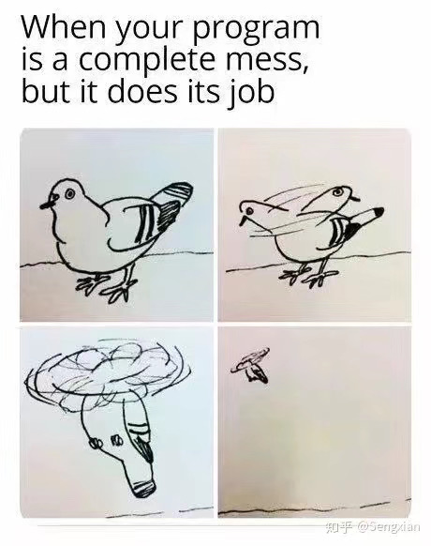
System Testing
Functional Behavior and Codes
Spec: The bird can fly…

Slide 18
System Testing
Topics in Testing Software
Usability

Slide 19
System Testing
Software Usability
Eventually a person will interact with a software system.
Software usability is how:
appropriate
functional
effective
that interaction is.
Ergonomics is the science of designing everyday things so that they are easy and functional to use.

Slide 20
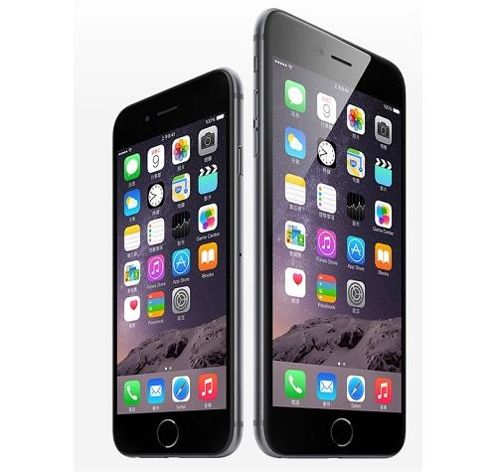
System Testing
Important traits of a good UI
Follows standards and guidelines
Intuitive
Consistent
Flexible
Comfortable
Correct
Useful

Slide 21
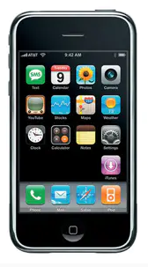
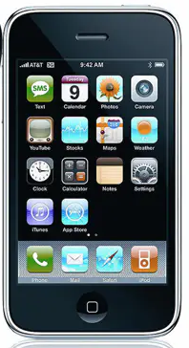
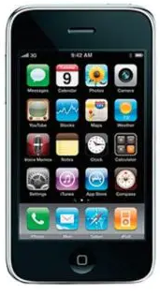
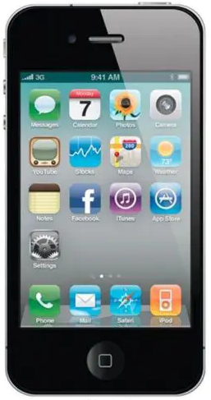
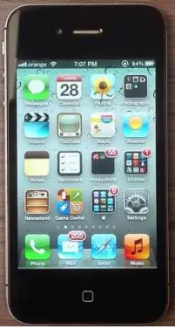
System Testing
Important traits of a good UI
iOS1-2007
iOS2-2008
iOS3-2009
iOS4-2010
iOS5-2011

Slide 22
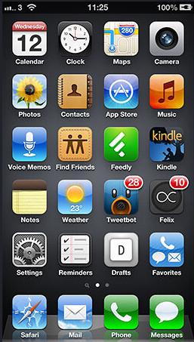
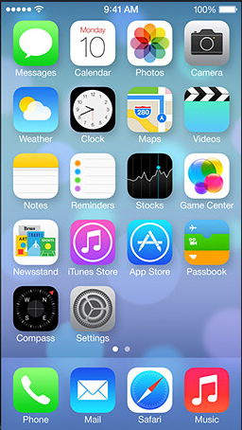
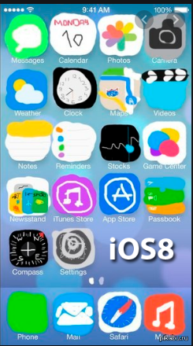
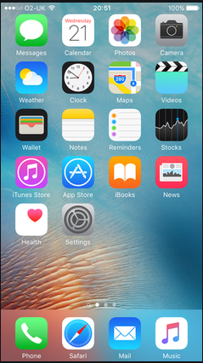
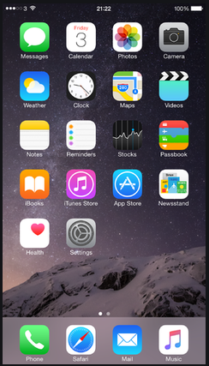
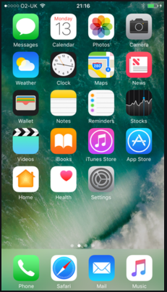
System Testing
Important traits of a good UI
iOS6-2012
iOS7-2013
iOS8-2014
iOS9-2015
iOS10-2016

Slide 23
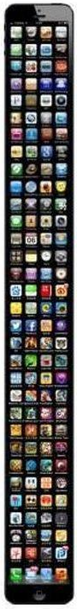
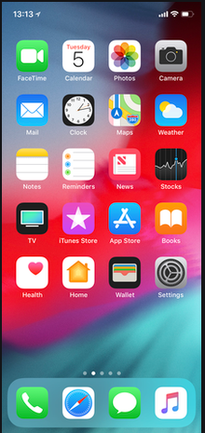
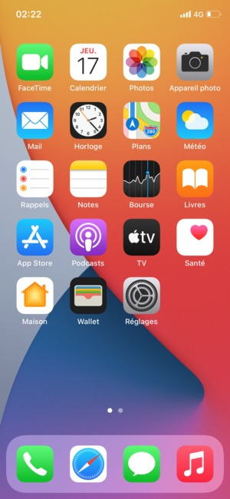
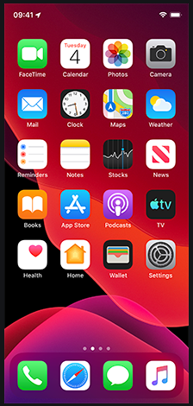
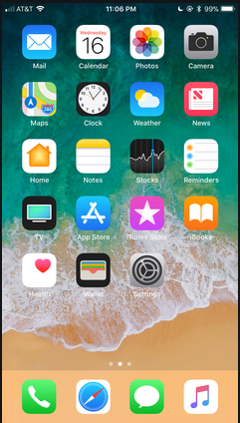
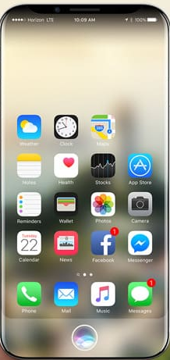
System Testing
Important traits of a good UI
iOS11-2017
iOS12-2018
iOS13-2019
iOS14-2020
iOS20?

Slide 24
System Testing
Follows UI standards and guidelines
Macintosh Human Interface Guidelines
http://developer.apple.com/documentation/UserExperience/Conceptual/OSXHIGuidelines/XHIGIntro/chapter_1_section_1.html
Microsoft Windows User Experience
http://msdn2.microsoft.com/en-us/library/aa511258.aspx
These guides detail how software that runs on each platform should look and feel to the user.
When should a check box be used instead of a button?
When is it proper to use information, warning, or critical messages?

Slide 25
System Testing
Follows UI standards and guidelines (cont’d)
The standards guidelines for a platform should be treated as an addendum to the product specification.
Test cases should be created based on the standards guidelines in addition to the test case created from the product’s specification.
If the development platform does not have a standard, the design team must create usability standards for the software itself.

Slide 26
System Testing
Intuitive UI
Is the UI clean, unobtrusive, not busy?
Are responses obvious and there when you expect them?
Is the UI organized and laid out well?
Are the inputs acknowledged?
Do the menus go too deep?
Is there excessive functionality?
Is there information overload?
Does the help system really help the user?

Slide 27
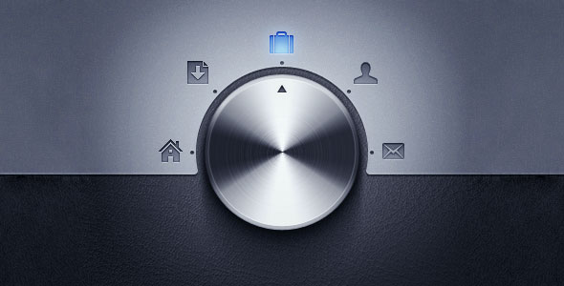
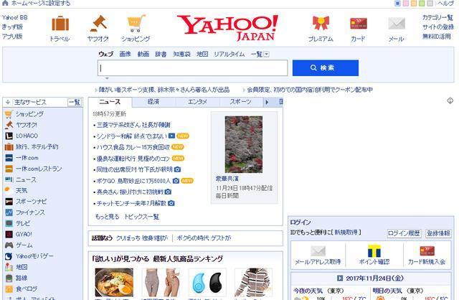
System Testing
Non-intuitive UIs

Slide 28
System Testing
Non-intuitive UIs

Slide 29
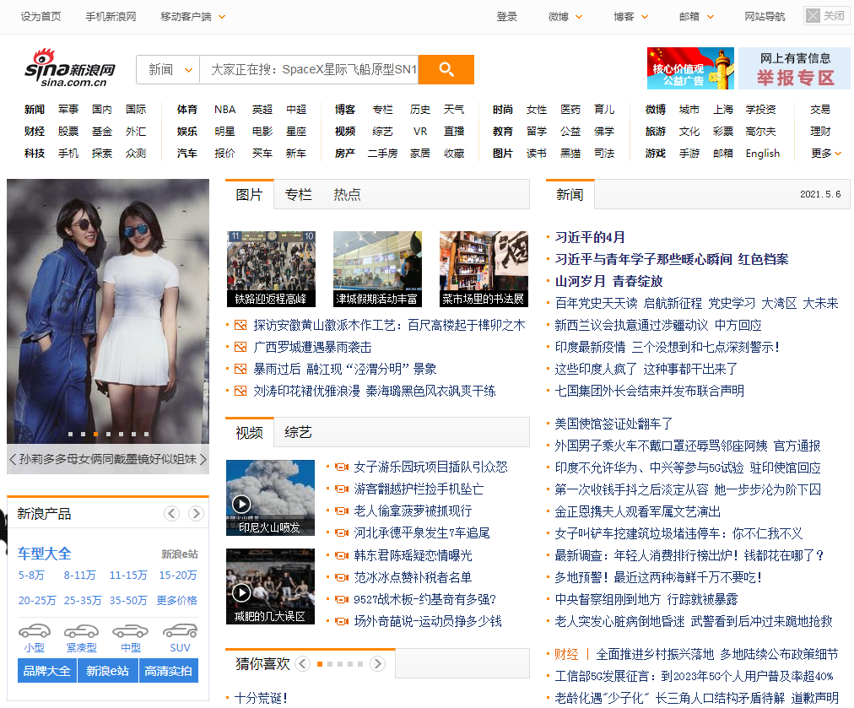
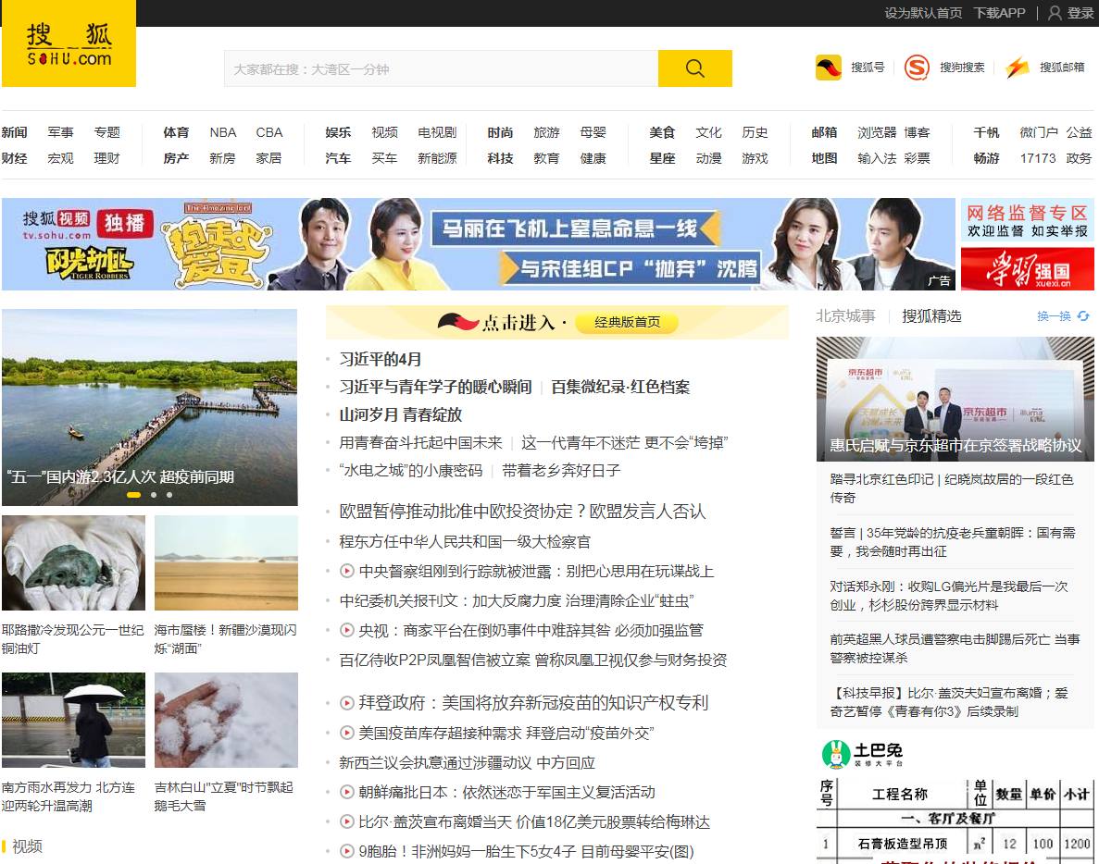
System Testing
Non-intuitive UIs

Slide 30

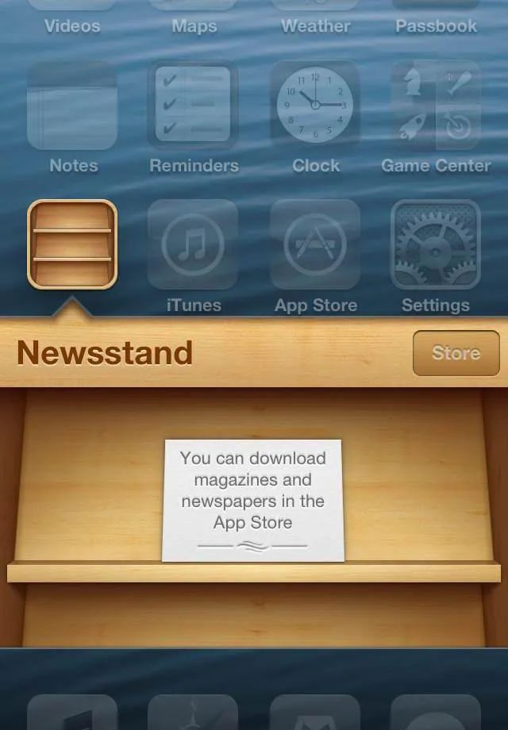
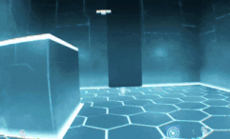
System Testing
Intuitive Ui (?)

Slide 31
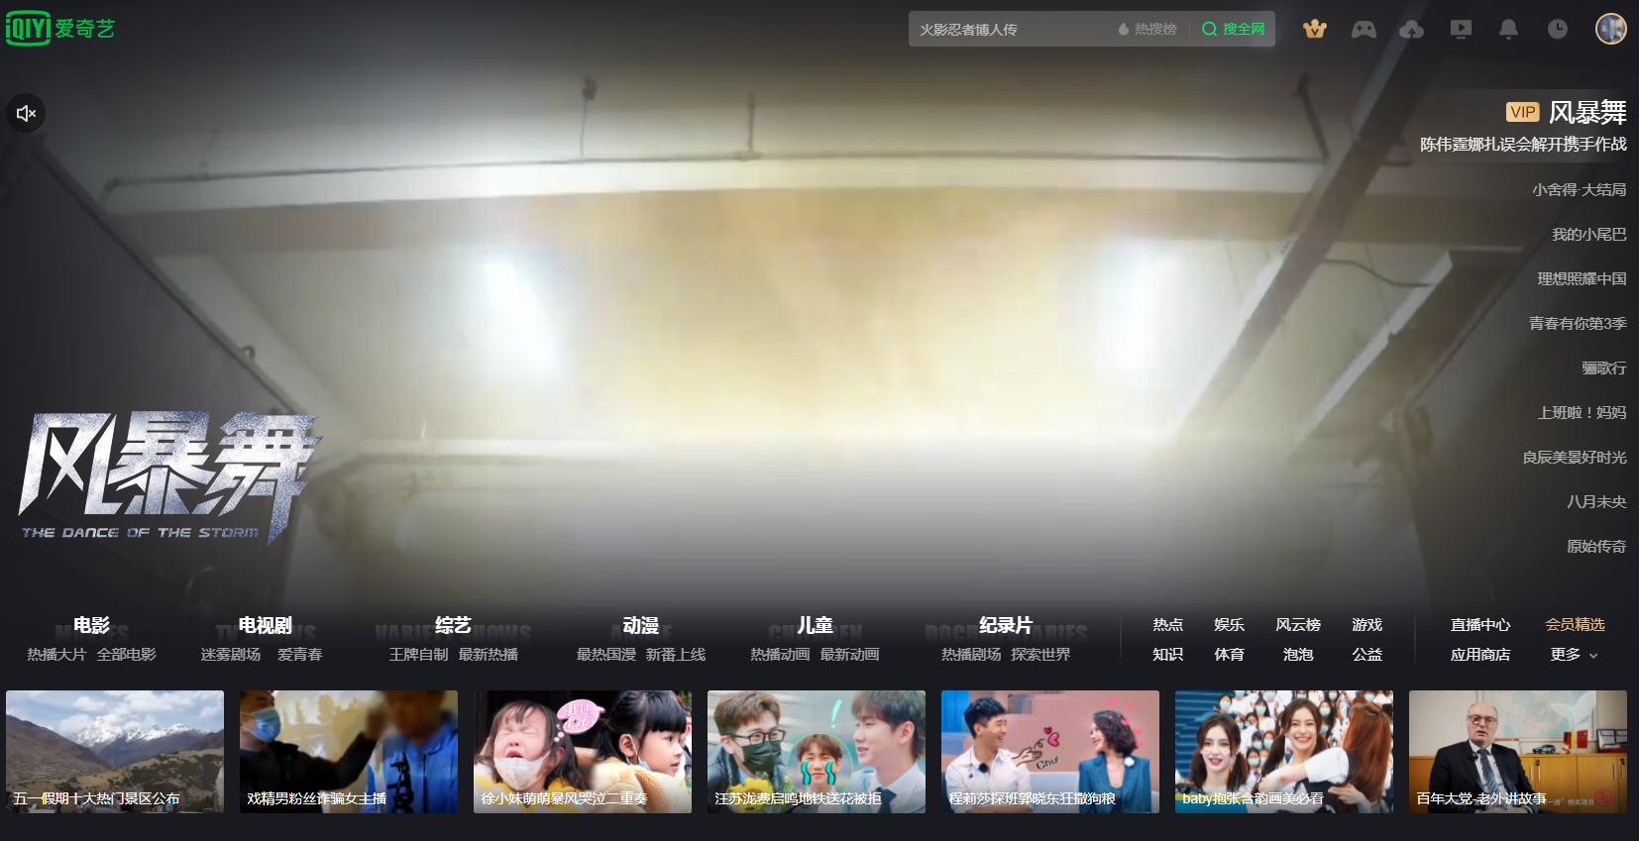
System Testing
Intuitive UI (?)

Slide 32
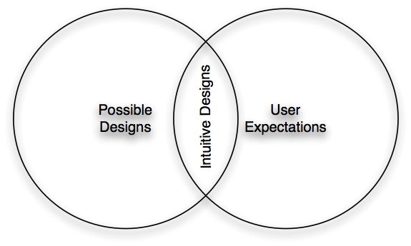
System Testing
Intuitive UI

Slide 33
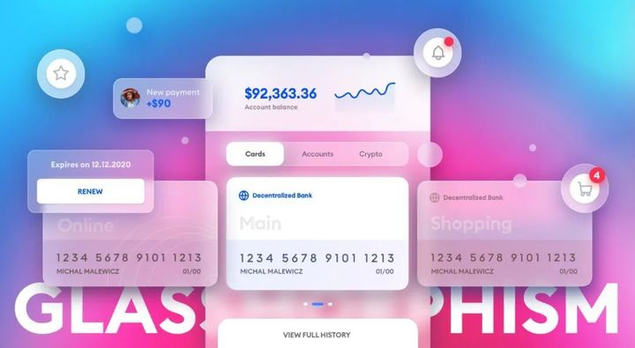
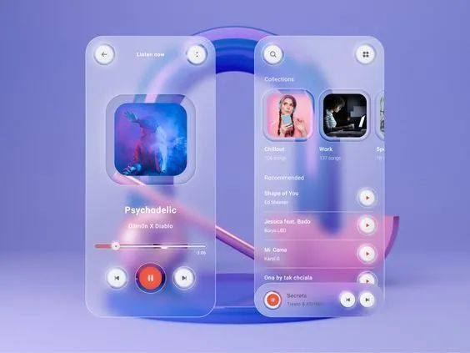
System Testing
Intuitive UI (?)

Slide 34
To be continued… See you next week

